Slide 1
Consumer & End User Insights Overview

Slide 2


What We Do
We combine our expertise in consumer and end user research with robust market data and the sector knowledge of experienced industry analysts. This provides holistic insights that support informed decisions.
.

Slide 3
Why BCC Research
Our 50+ years experience has allowed us to develop deep, long-standing relationships with the world’s biggest life science and physical science brands. Clients choose BCC Research for our unique blend of capabilities, market expertise and our responsive and flexible client service.
Our Consumer & End User Insights team provides a high quality, tailored service that supports clients in strategic decision making; propelling their business forward by providing actionable insights that support informed decisions.

Slide 4
Why It Works
1
BCC Research provides insight-led reporting, focused on bringing together multiple data sources that deliver meaningful and actionable insights for our clients.
2
We build bespoke, mixed methodology programs that answer challenging briefs by blending multiple elements of our methodological toolkit, off-the-shelf data and sector knowledge.
3
Through our dedication to outstanding client service, and unique approach to consumer and end user insights, clients are given a high quality, tailored service and findings that have a profound and tangible impact on their organization.

Slide 5






Capabilities
Market understanding and opportunities
Product & service development
Market sizing & trends
Audience & market segmentation
Concept testing
Usage & attitudes
Product development
Market entry strategy
Pricing strategy
Brand perceptions & tracking
Partner selection
Voice of the customer & NPS
Content strategy
Customer journey mapping
Campaign Evaluation
Channel analysis
Sponsorship impact
Shopper behaviour
Customer experience & purchase journey
Content and communication effectiveness

Slide 6
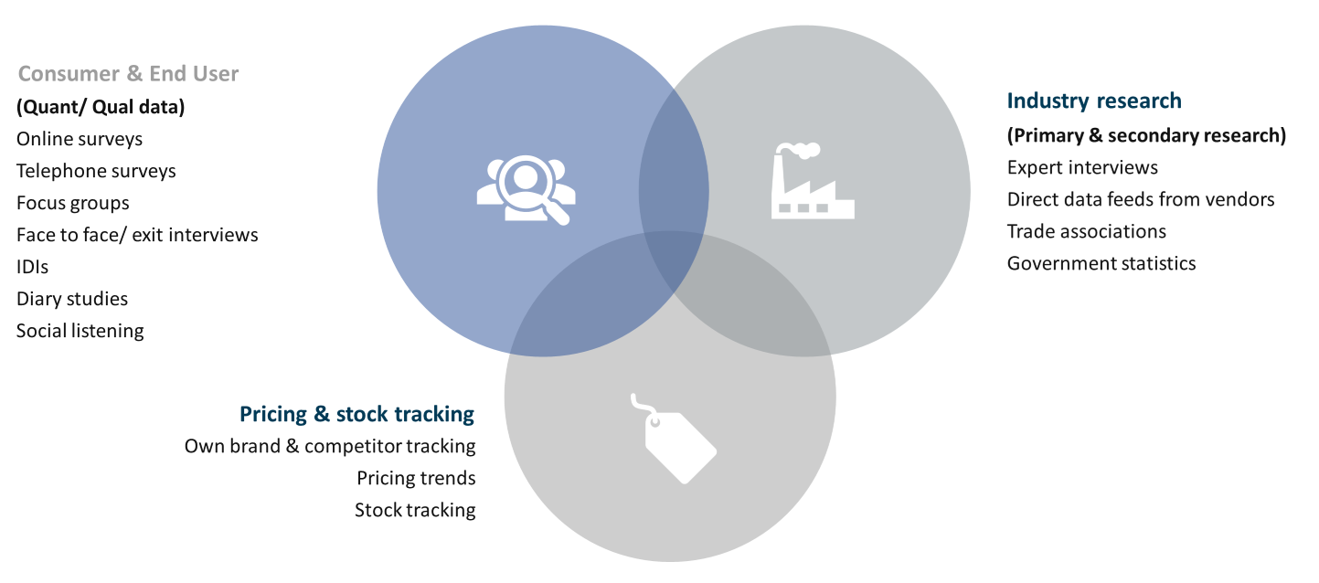
Methodologies
BCC Research uses a mixture of methodologies, in order to provide a 360-degree view of each industry. From bespoke custom projects through to multi-client subscription services, our consumer & end user insights team works side by side with expert market analysts to deliver actionable insights, underpinned by a range of stringent methodologies.

Slide 7
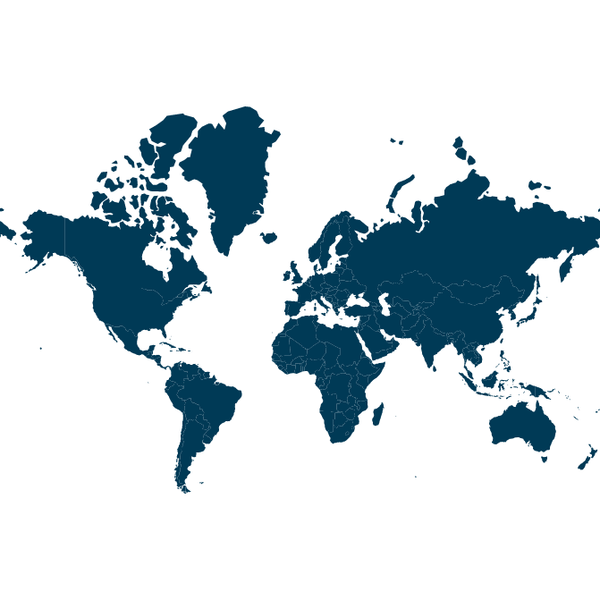
Country Coverage
Consumer & end user research capabilities in over 90 markets worldwide
Proven experience across all world regions - regularly carry out international research covering large numbers of countries
Research carried out in local language and takes local nuances into account – BCC Research has a deep understanding of industry trends and cultural nuances in local markets, ensuring the quality of our international research is high

Slide 8
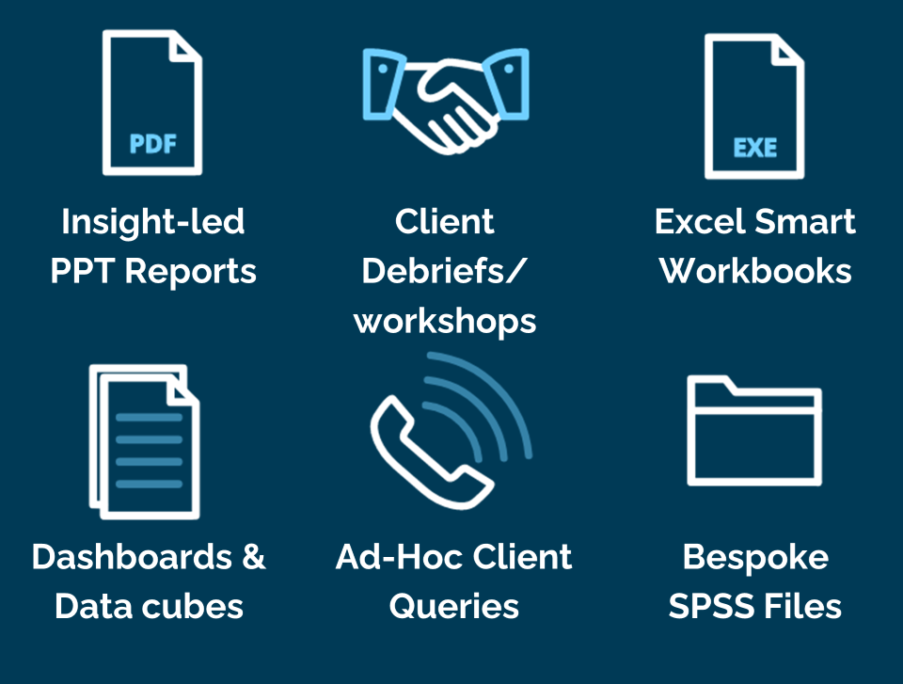
Deliverables

Slide 9
Wide-Range Expertise
Materials
Plastics
Chemicals
Advanced Materials
Nanotechnology
Semiconductor
Life Science
Medical Devices
Cell Bio
Pharma
Health Maintenance
Environment / Sustainability
Water Membrane
Fuel Cell
Energy
Food
Manufacturing
Commerce
Finance
IT
Venture Capital
Startups
Sensors
Engineering
Photonics
Safety/Security
Instruments

Slide 10

BCC at a Glance
Strong Presence in 70+ countries
Welcomed 200% more tech
transfer offices over the past three
years.
High member satisfaction with 90% retention rate yearly resulted from
unmatchable customer service.
Partners with high-impact organizations, including AUTM.
25 Categories in Life Science, Materials, Sensors, Commerce and Environment/ Sustainability.
Analysts have decades of
industry experience and featured in NYT, WSJ, Forbes.
Featured publications in scientific journals, including American Ceramics Society (ACerS), Society of Vacuum Coaters (SVC).
More than 30% of topics suggested by members
More than 40% of top
ranked universities
in North America are members.

Slide 11
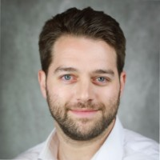
Contact Us
Elliott Ross heads up BCC Research’s Consumer & End User Insights team. He has 14 years’ industry experience and is adept at designing and implementing custom-made research programs that bring together an optimal mix of methodologies and data sources.
  E: elliott.ross@bccresearch.com
  T: [+44] 01582 500 153
  W: www.bccresearch.com

